Slide 1
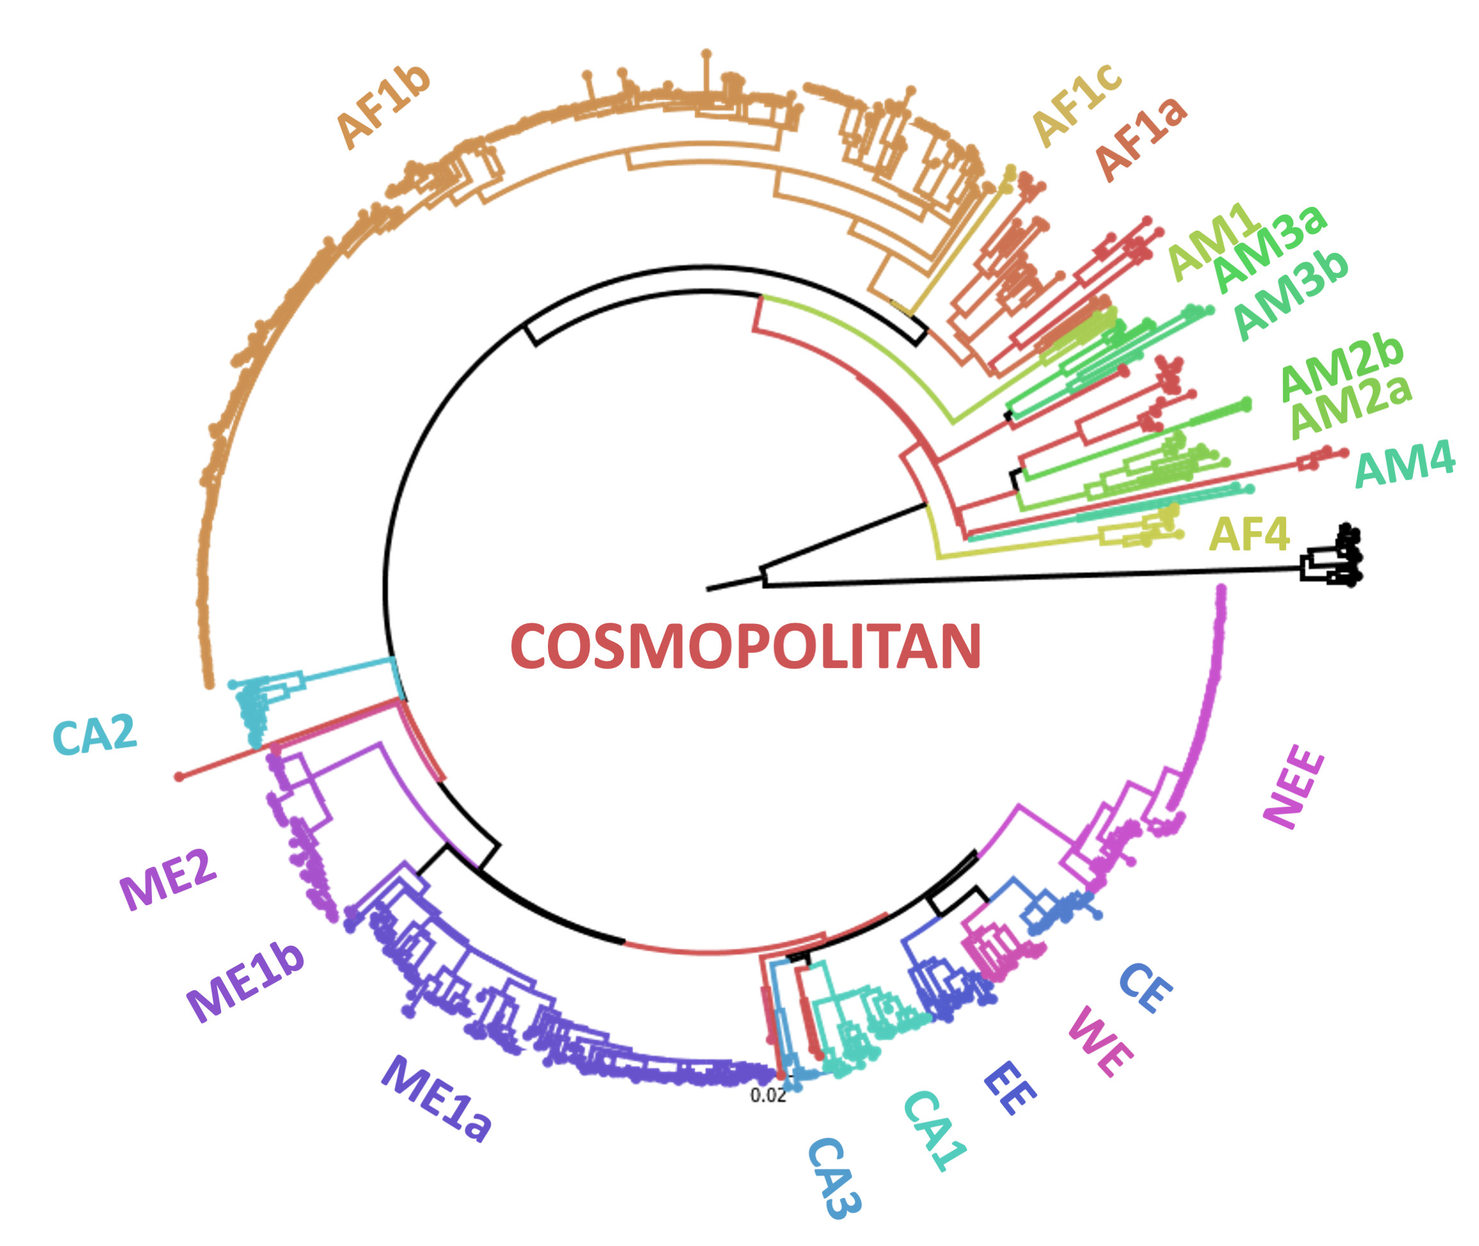
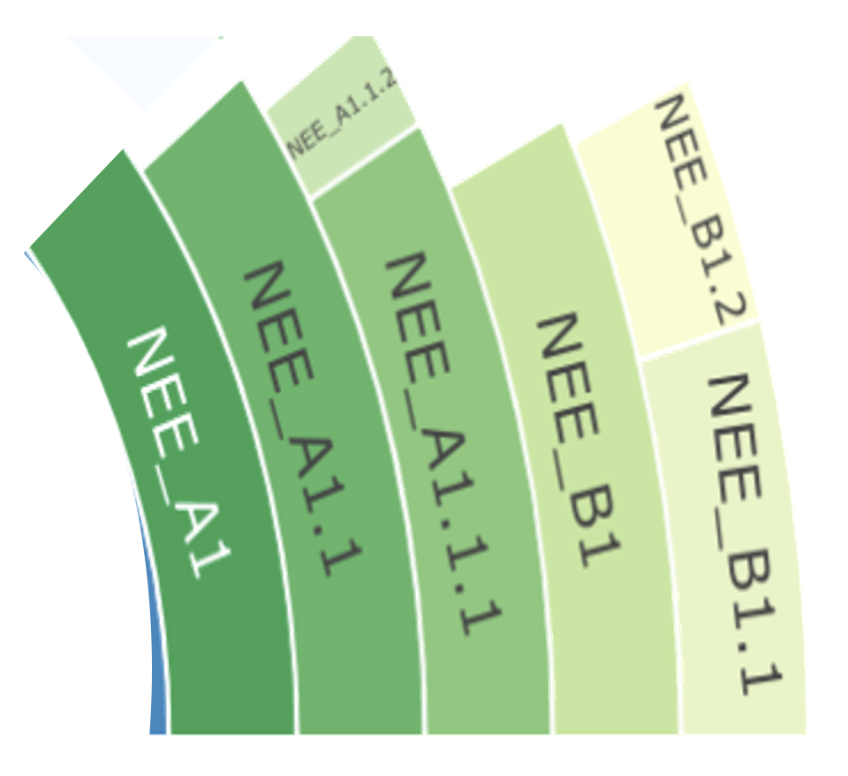
Clade
Subclade
Minor lineage
Major lineage
Notes:
Fig 1. Illustration of rabies virus clades, subclades and lineages. Maximum likelihood tree of all publicly available whole genome rabies virus sequences (n=650) coloured by previously identified subclades [13]. The NEE subclade has been expanded to show major and minor lineages from the updated MADDOG classification system.

Slide 2
Sequences from GenBank
User input sequences
INPUT
Curation
Web interface to database
Reference alignments, trees and sequences
Input sequences compared to references
PROCESSING
Options to filter
Downloadable sequences, metadata and alignments
Genome visualization and comparison to reference
Clade assignment
Placement in phylogenetic tree
Sequence and metadata upload to GenBank
OUTPUT
Notes:
Fig 2. Schematic of the online capabilities of RABV-GLUE.

Slide 3
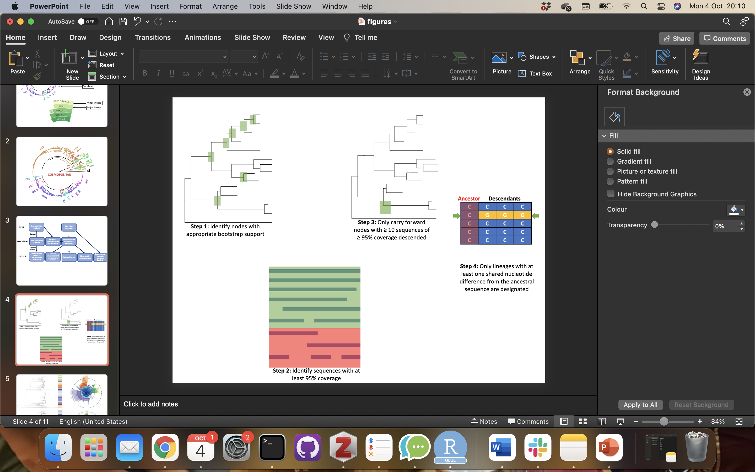
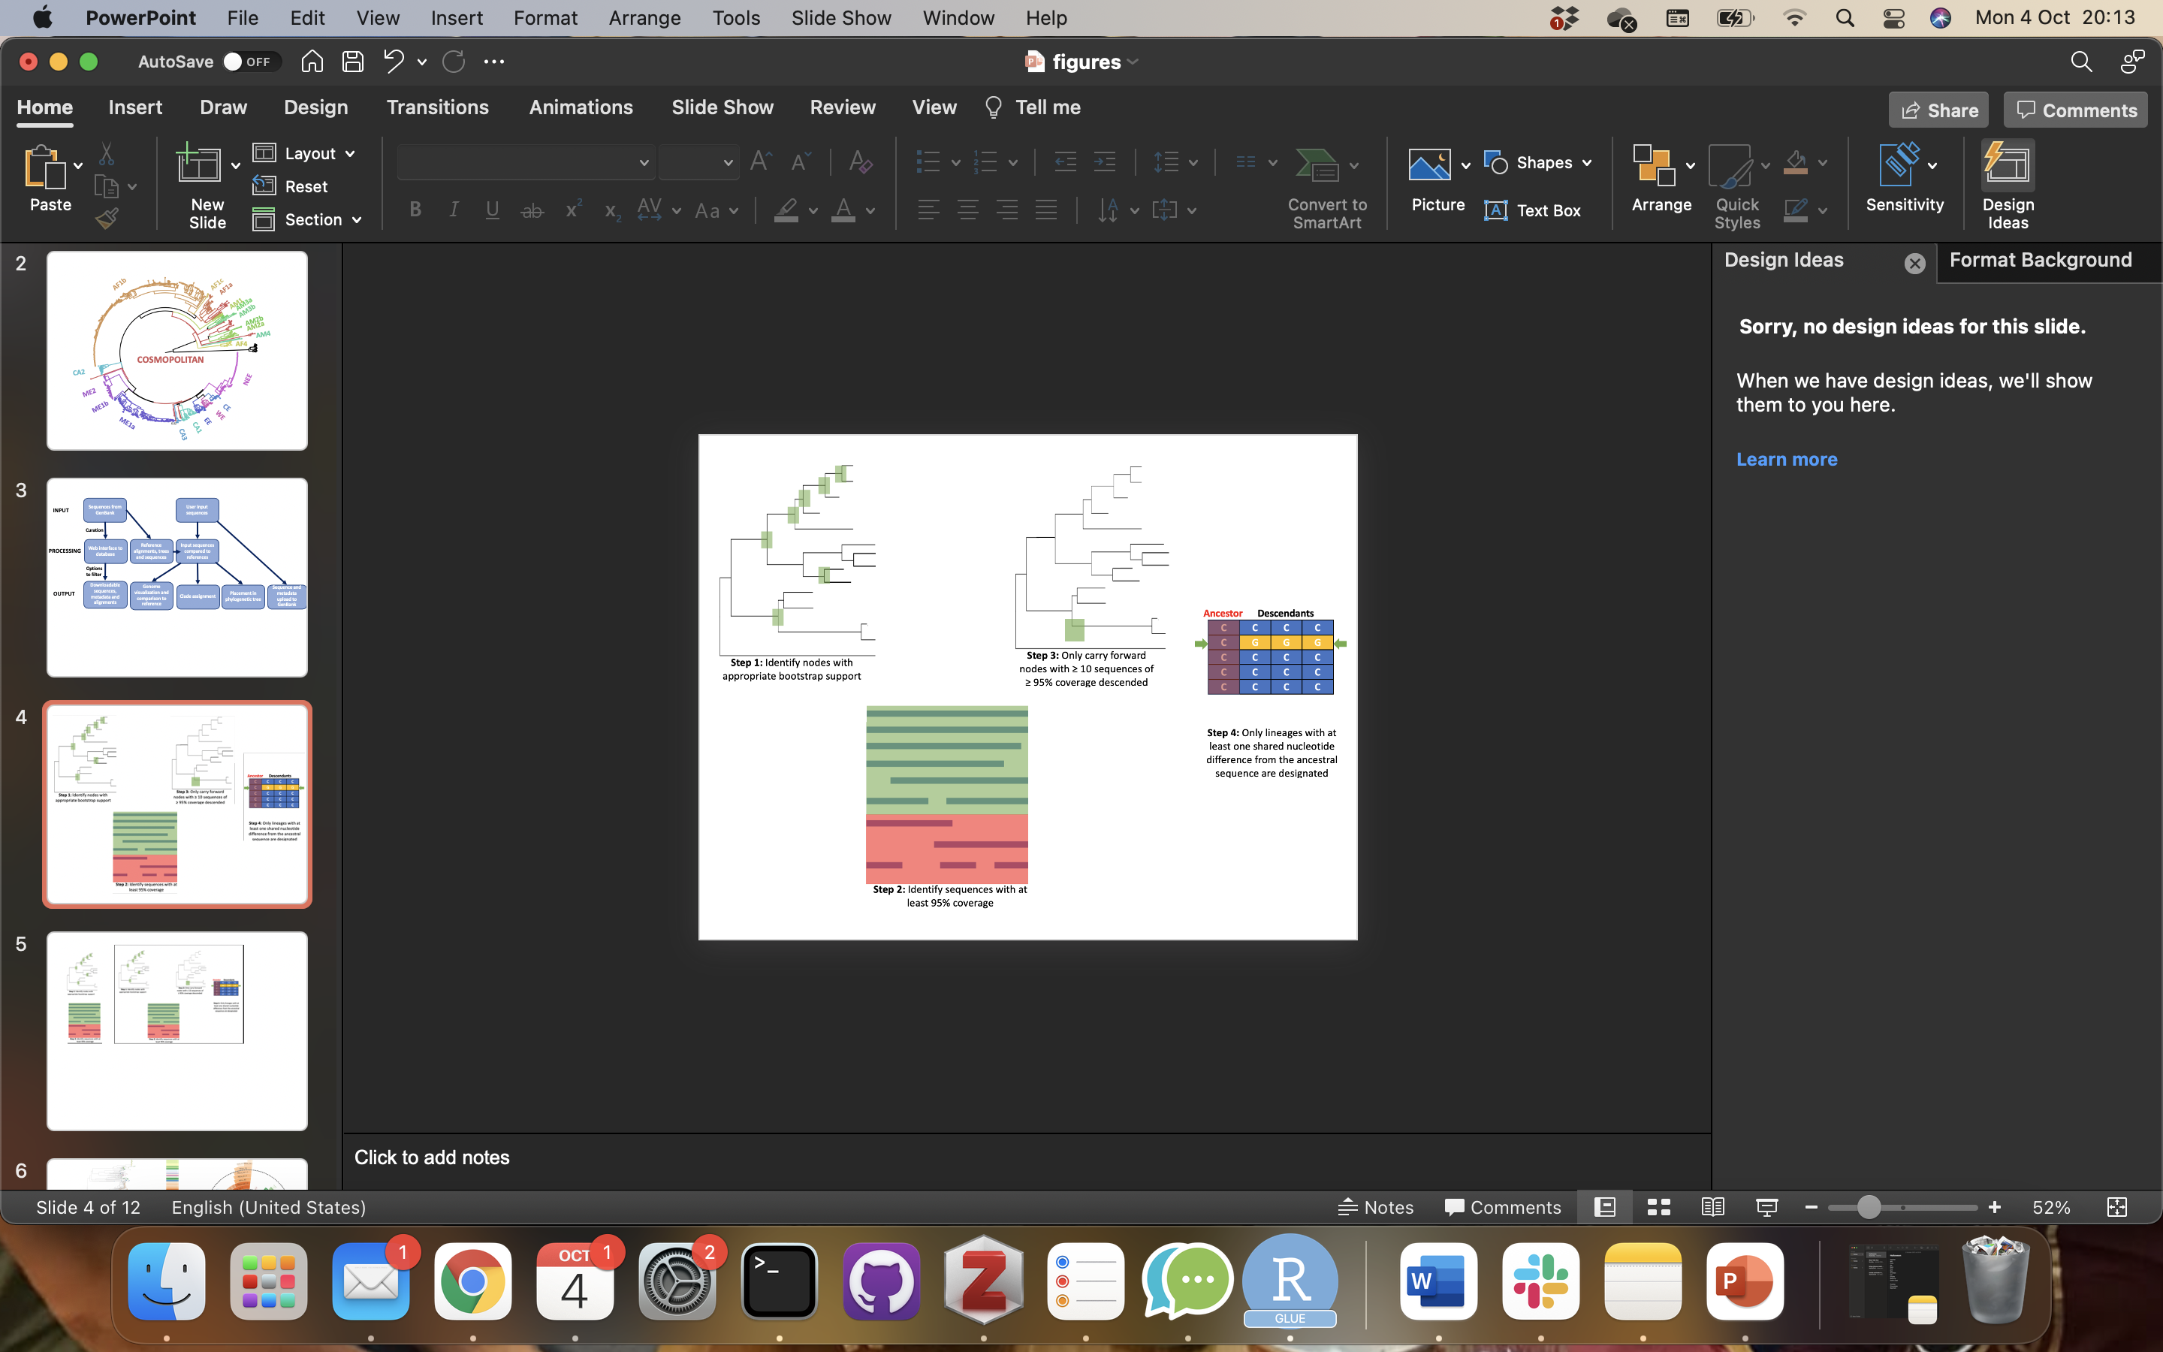
Step 4: Only lineages with at least one shared nucleotide difference from the ancestral sequence are designated
Step 3: Only carry forward nodes with ≥ 10 sequences of ≥ 95% coverage descended
Step 1: Identify nodes with appropriate bootstrap support
Step 2: Identify sequences with at least 95% coverage
Notes:
Fig 3. Summary of lineage designation steps.

Slide 4
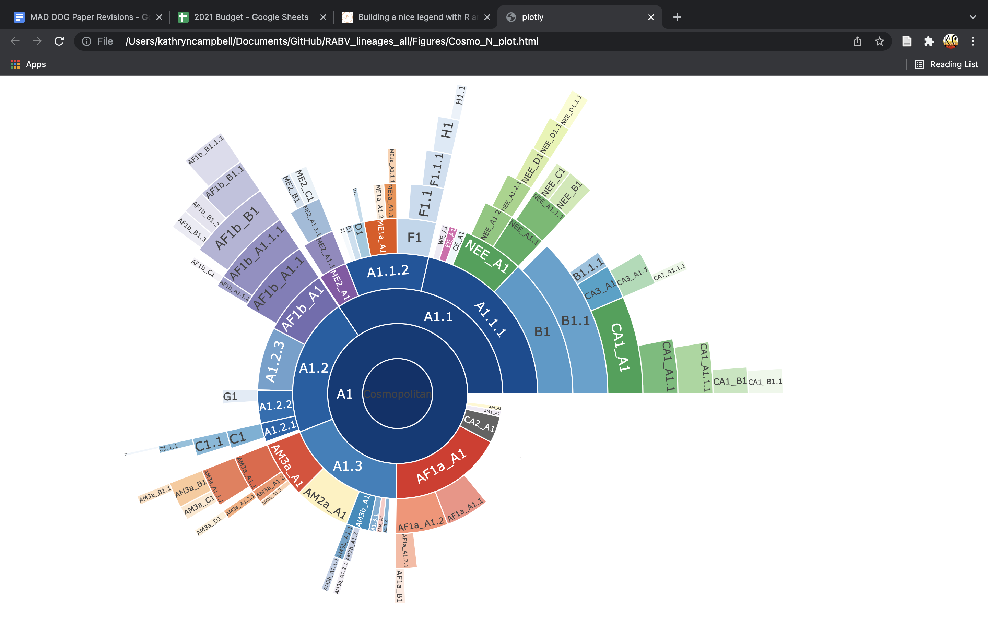
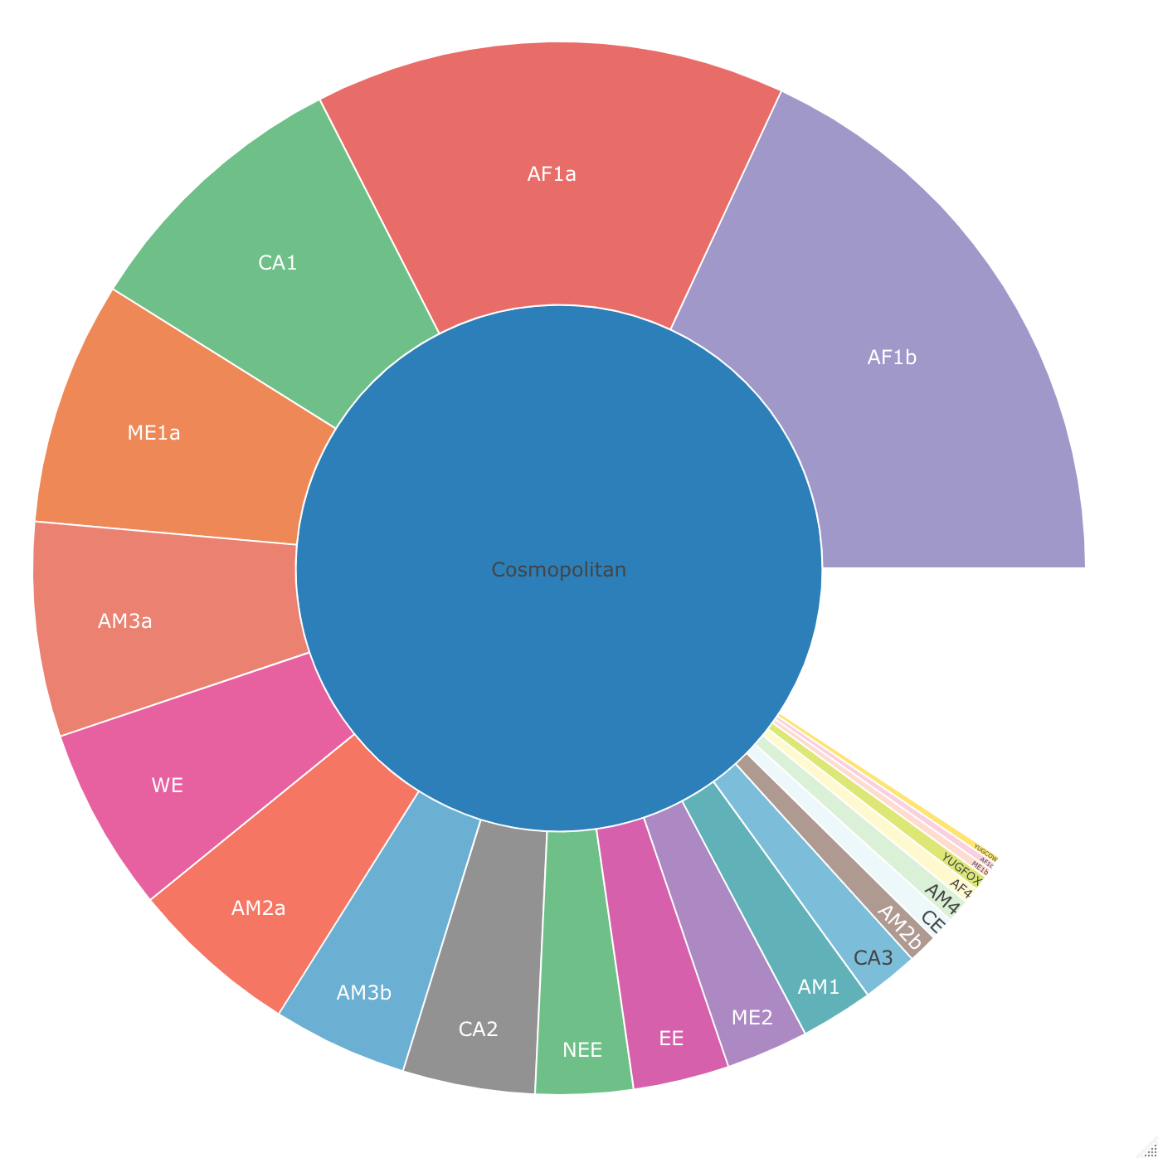
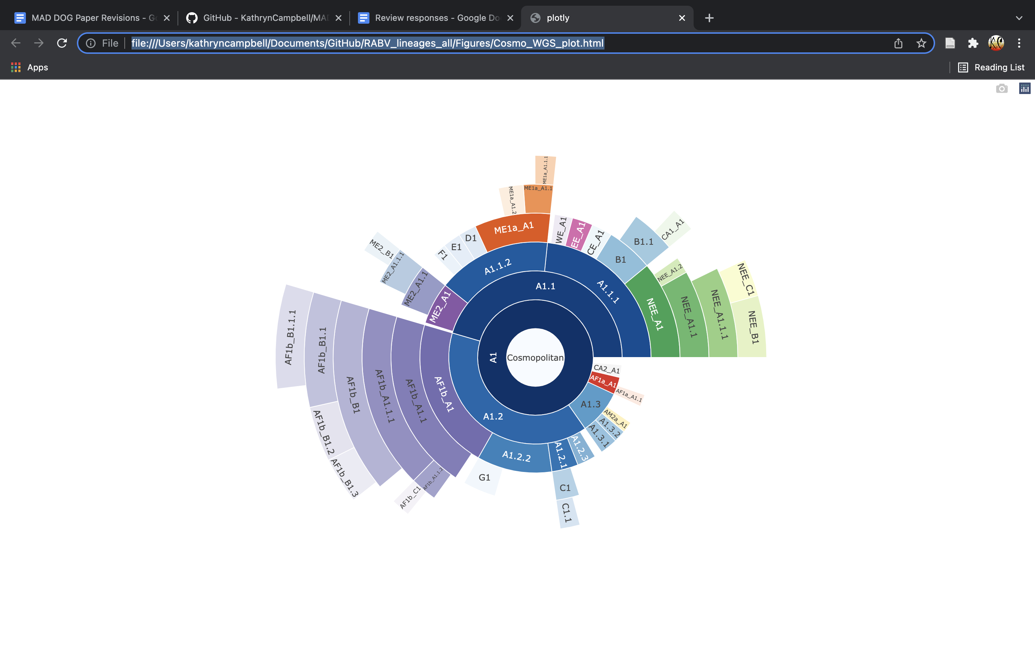
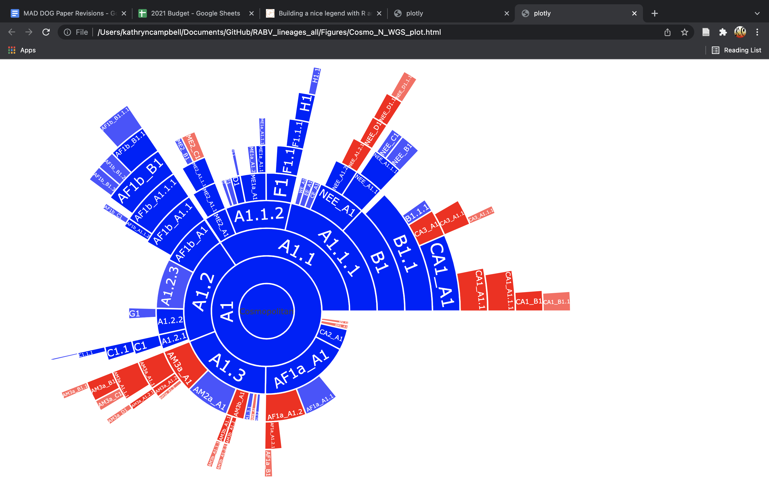
A
Cosmopolitan
0.02
B
Existing Classification
Whole Genome Lineages
Adding N Gene Lineages
Whole genome lineages
Additional N gene lineages
Notes:
Fig 4. Lineage designations of whole genome and N gene sequences from the RABV Cosmopolitan clade. A: Maximum likelihood tree showing the lineage positions, rooted using an outgroup of 10 Asian SEA1b sequences, with scale indicating substitutions per site per year, and hierarchical relationships with dashed lines indicating 5 lineage iterations (n=2608 total sequences for tree and sunburst plot, combing both WGS and N gene sequences). B: Progression of classification definition from 22 previously defined subclades (left) to 52 lineages using only whole genome sequences (middle) to 147 lineages adding N gene sequences, with lineages seen at whole genome level in blue and additional lineages only seen at N gene level in red (right).

Slide 5
No. Sequences
1 - 5
6 - 10
11 - 25
26 - 50
51 - 100
101 - 200
>200
Notes:
Fig 5. Distribution of RABV lineages from the Cosmopolitan clade determined from WGS and N gene sequences. Circle size indicates the number of sequences (sum of both WGS and N gene sequences), with circles plotted to the centroid of each country. Sunburst plot from Fig 4A included to indicate colour scheme. Base layer of map from Natural Earth.
1:5 = Madagascar
6:10 = France
11:25 = Russia
26:50 = S.Africa
51:100 = Hungary
101:200 = Iran
201+ = Tanzania

Slide 6
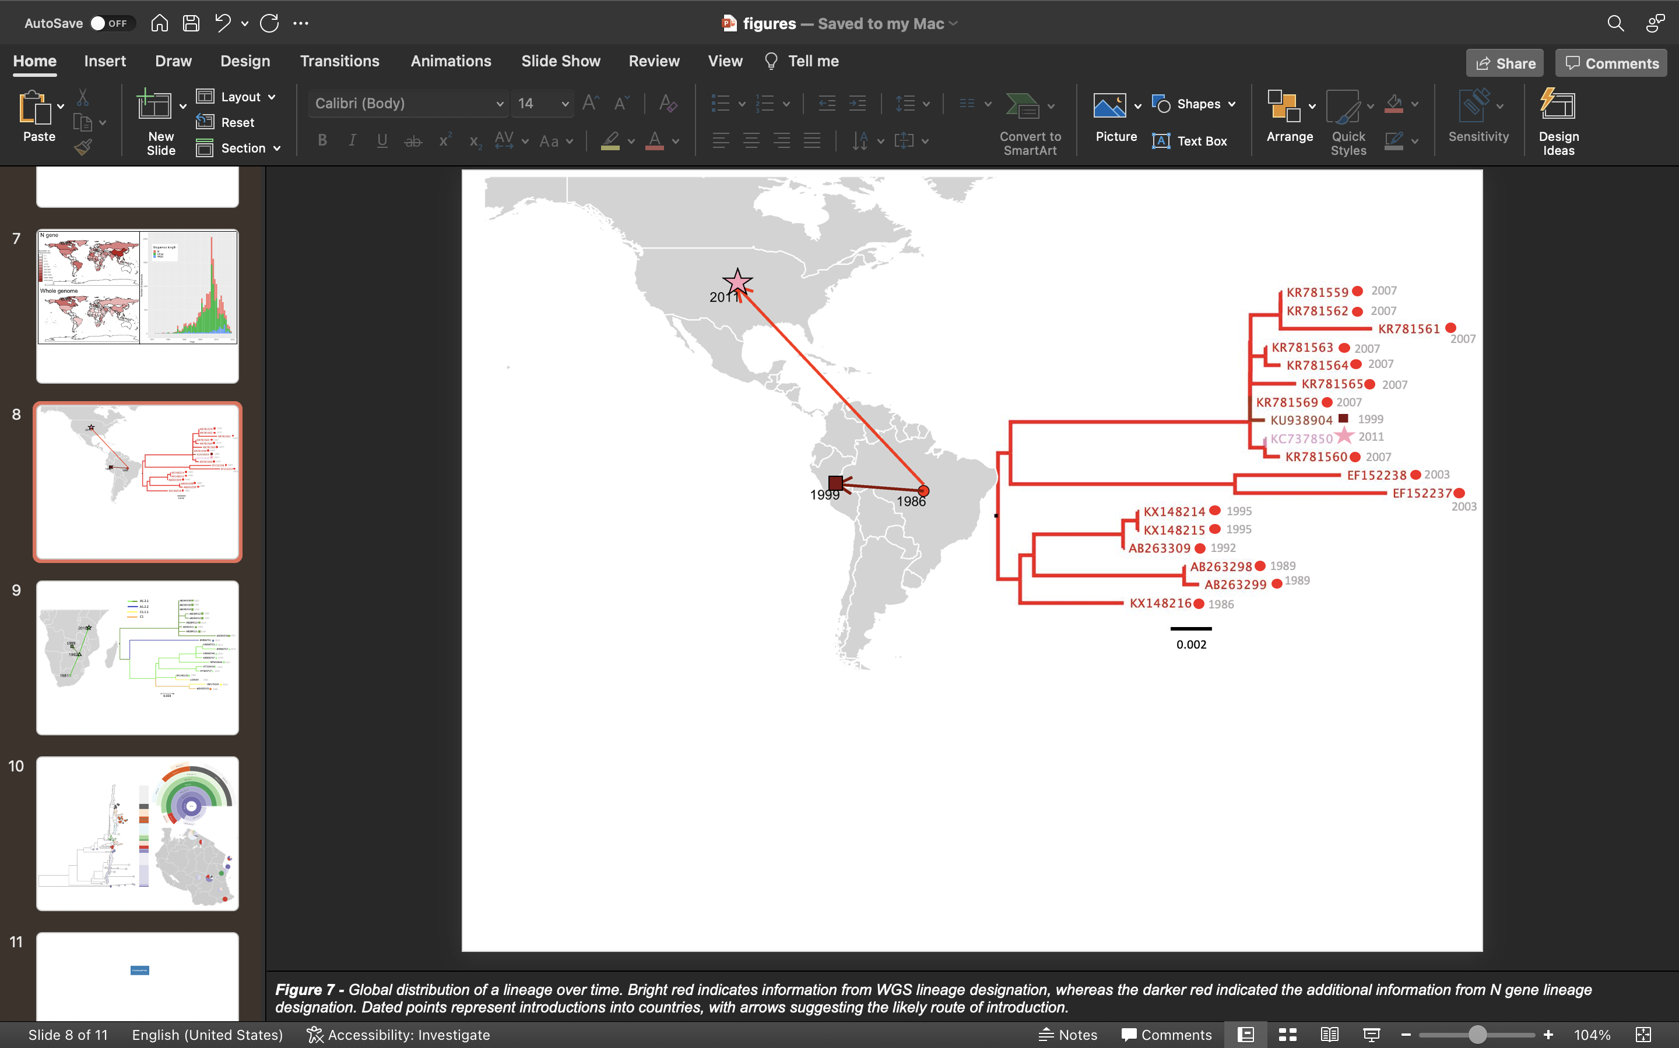
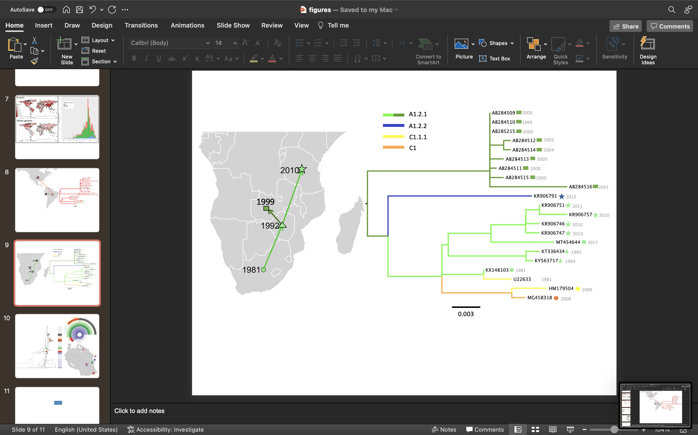
A
B
Notes:
Figure 6. Case studies identifying an imported human rabies case and reconstructing historical spread of RABV into Tanzania. Dated points represent first records of the lineage in the country, with arrows suggesting the likely source of introductions. Scale indicates substitutions per site per year. Base layer of maps from Natural Earth. A: Left: Countries where AM3a_A1.3 has been isolated over time. Bright red = information from WGS lineage designation, darker red = additional information from N gene lineage designation. The star indicates the human rabies case. Right: Maximum likelihood Subtree of AM3a_A1.3 lineage, with icons to indicate country of origin, B: Left: Countries where lineage A1.2.1 has been isolated over time. Bright green = information from WGS lineage designation, darker green = additional information from N gene lineage designation. The star indicates case of interest. Right: Maximum likelihood subtree of A1.2.1 lineage and descendants, with icons to indicate country of origin, corresponding to map, and dated tips.

Slide 7
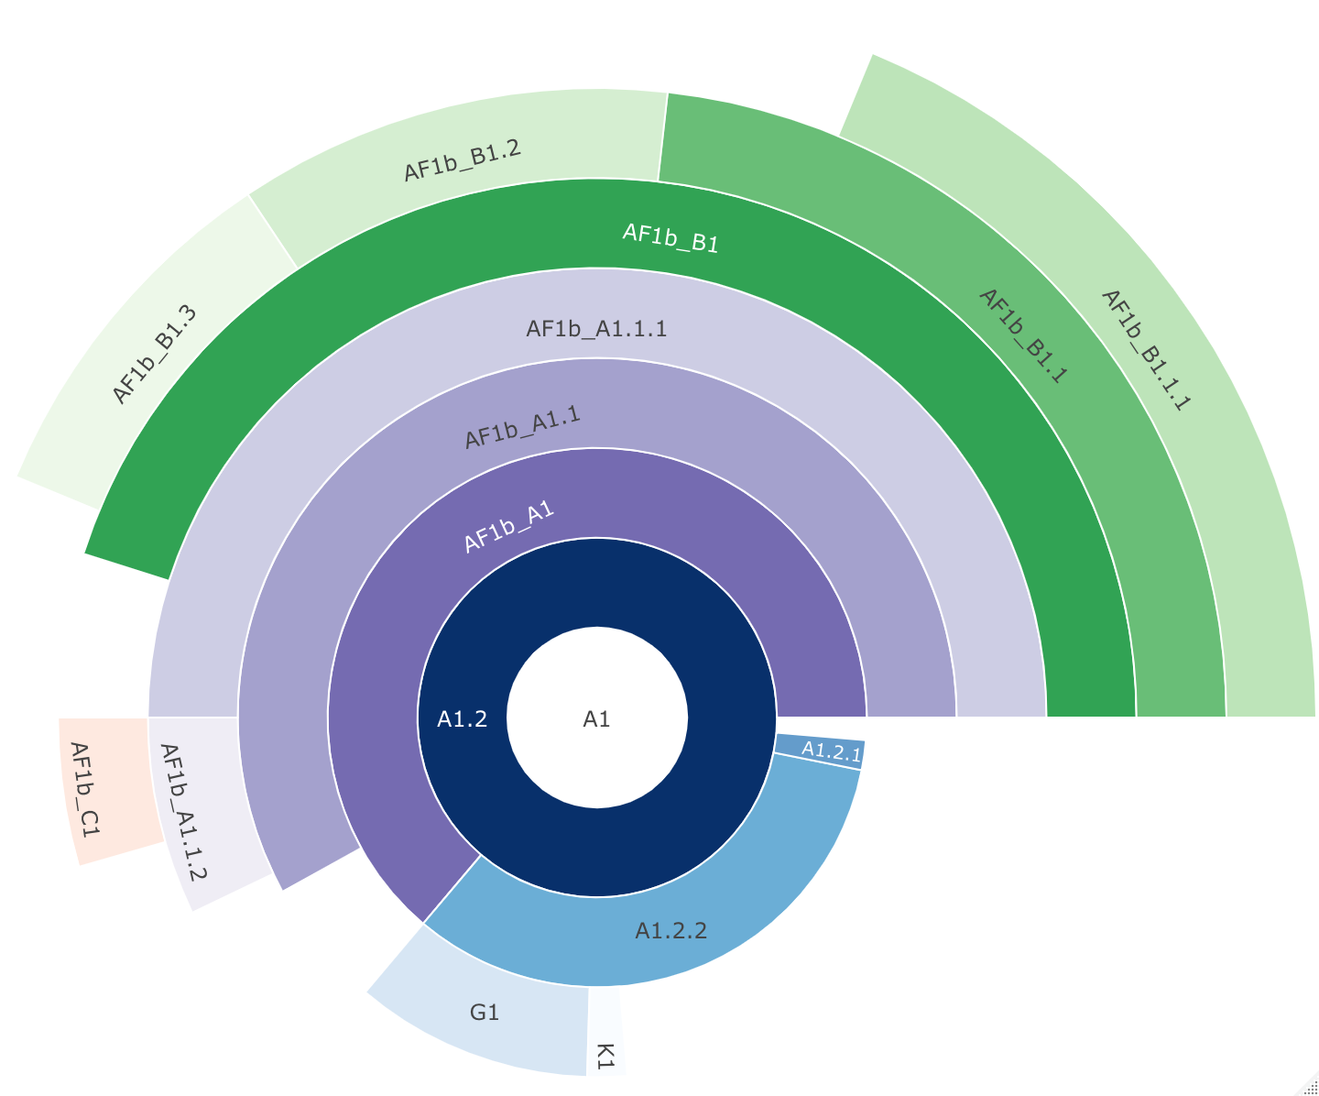
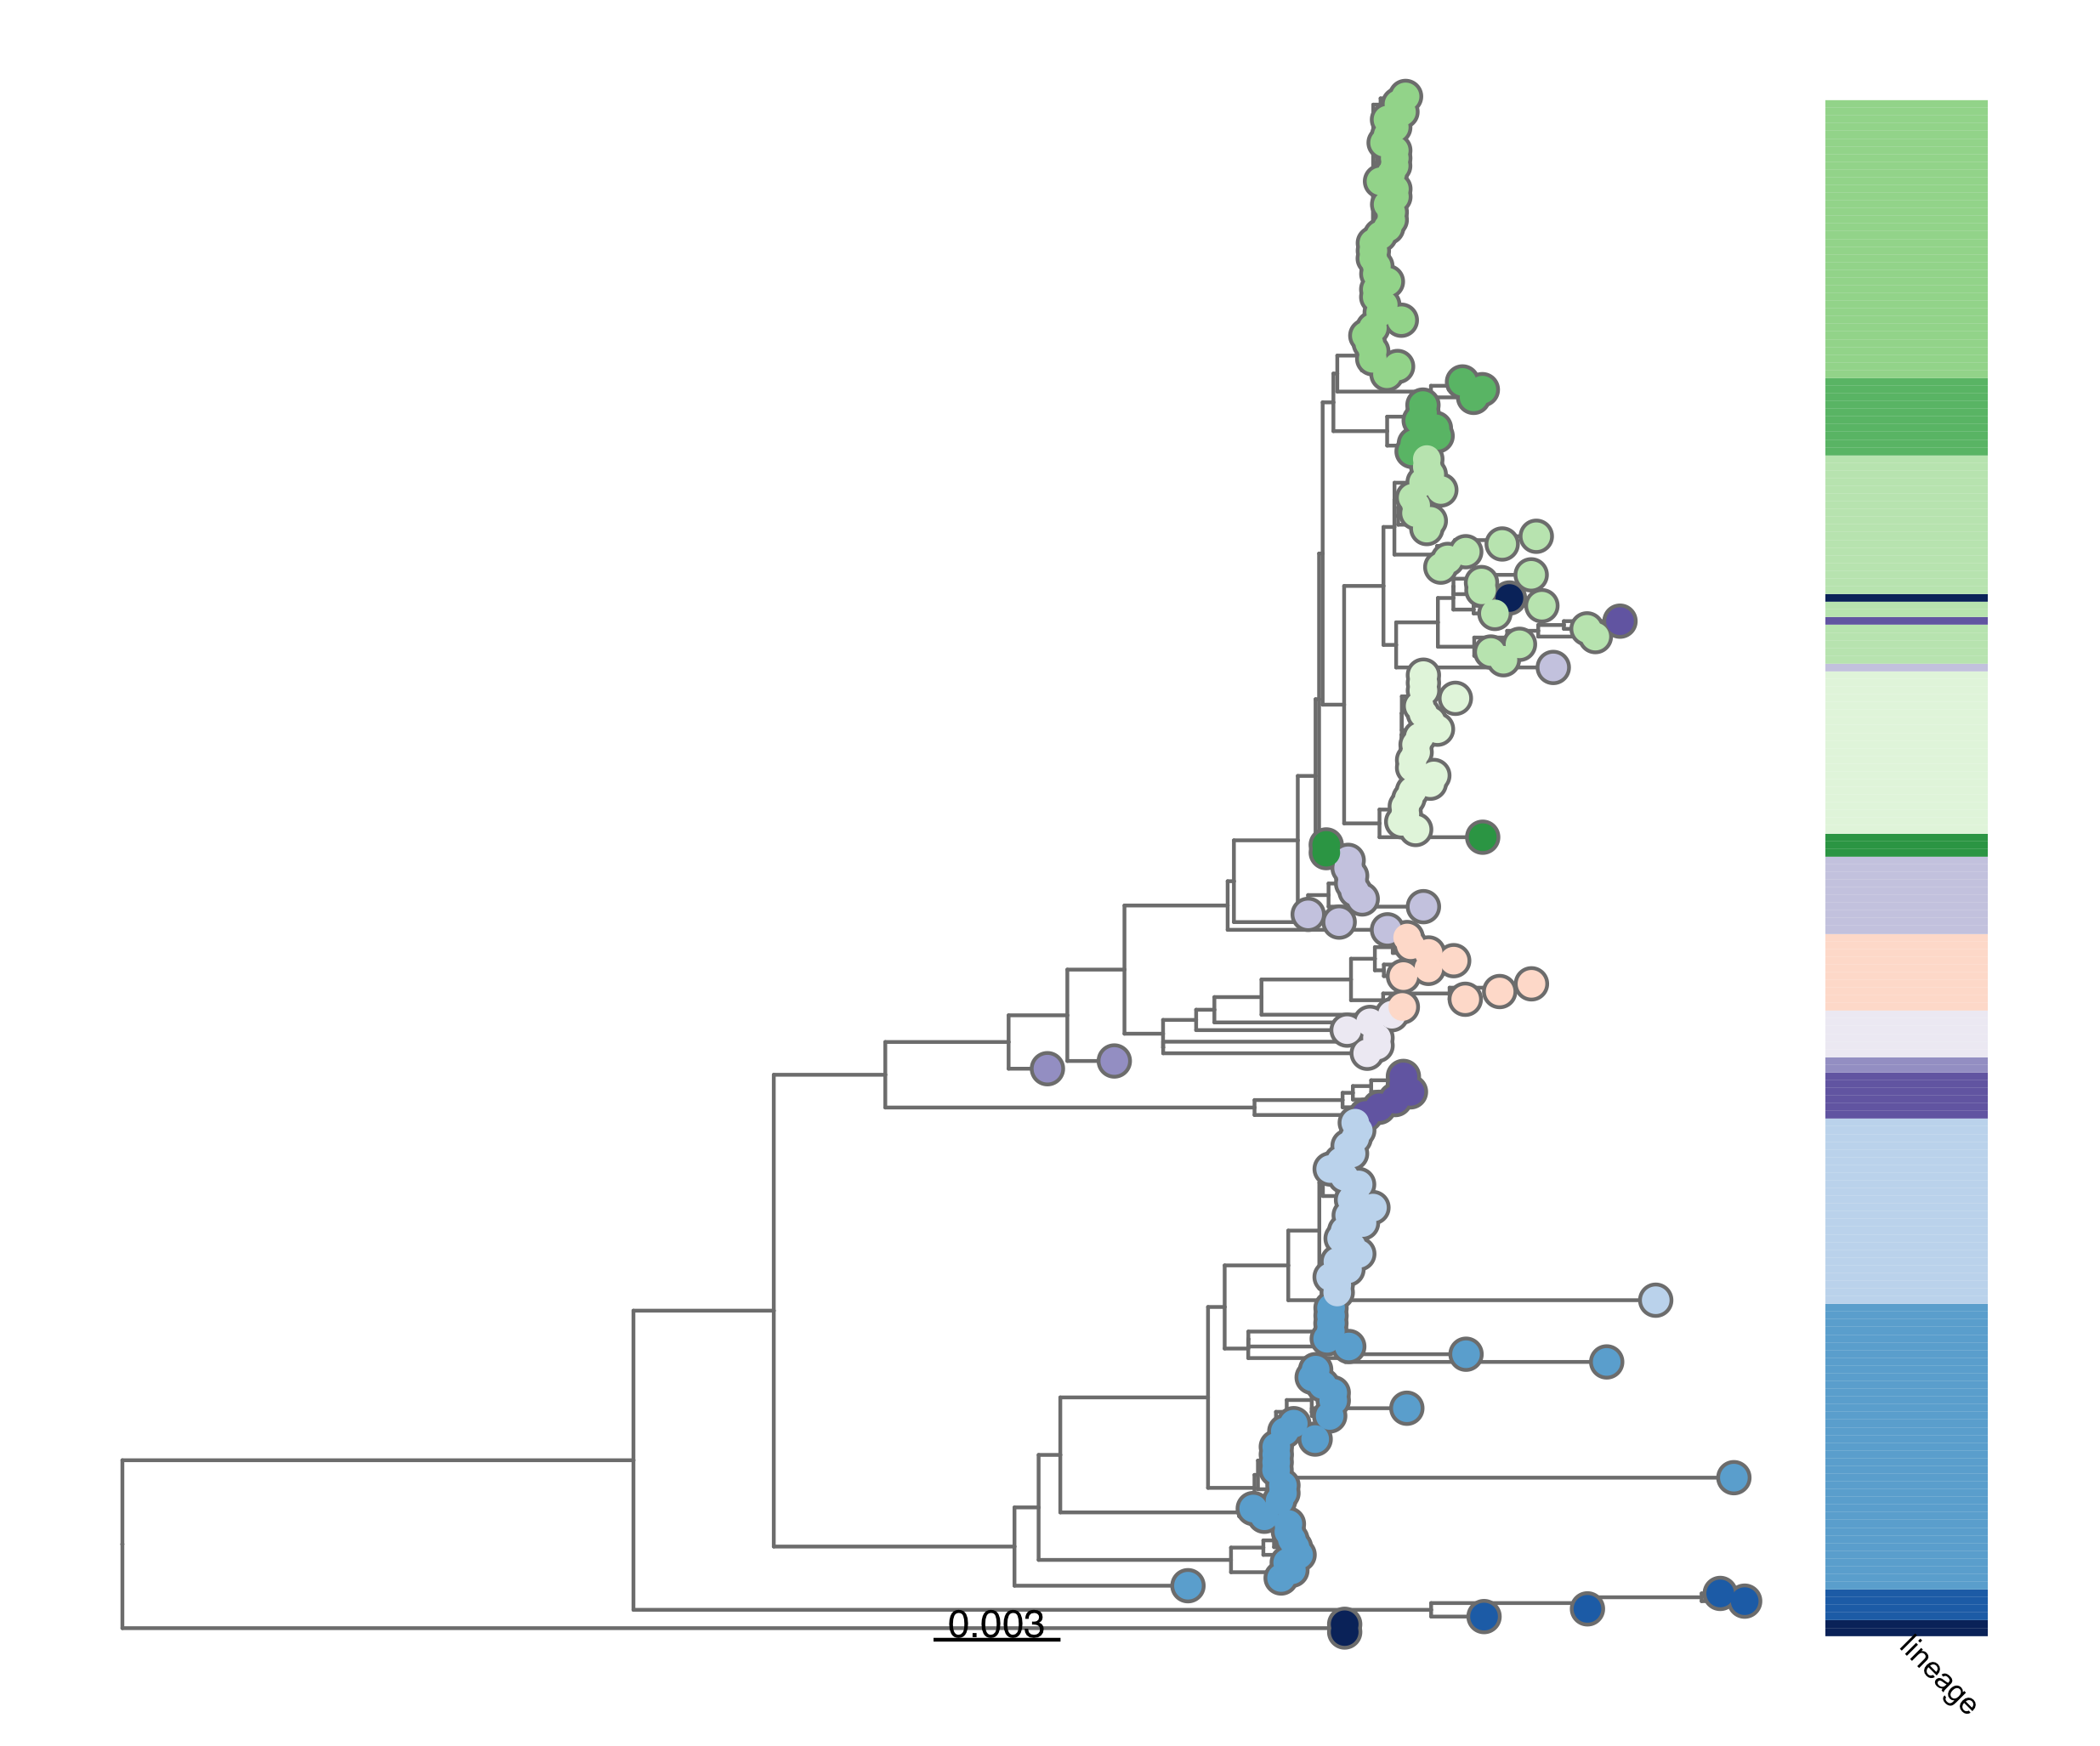
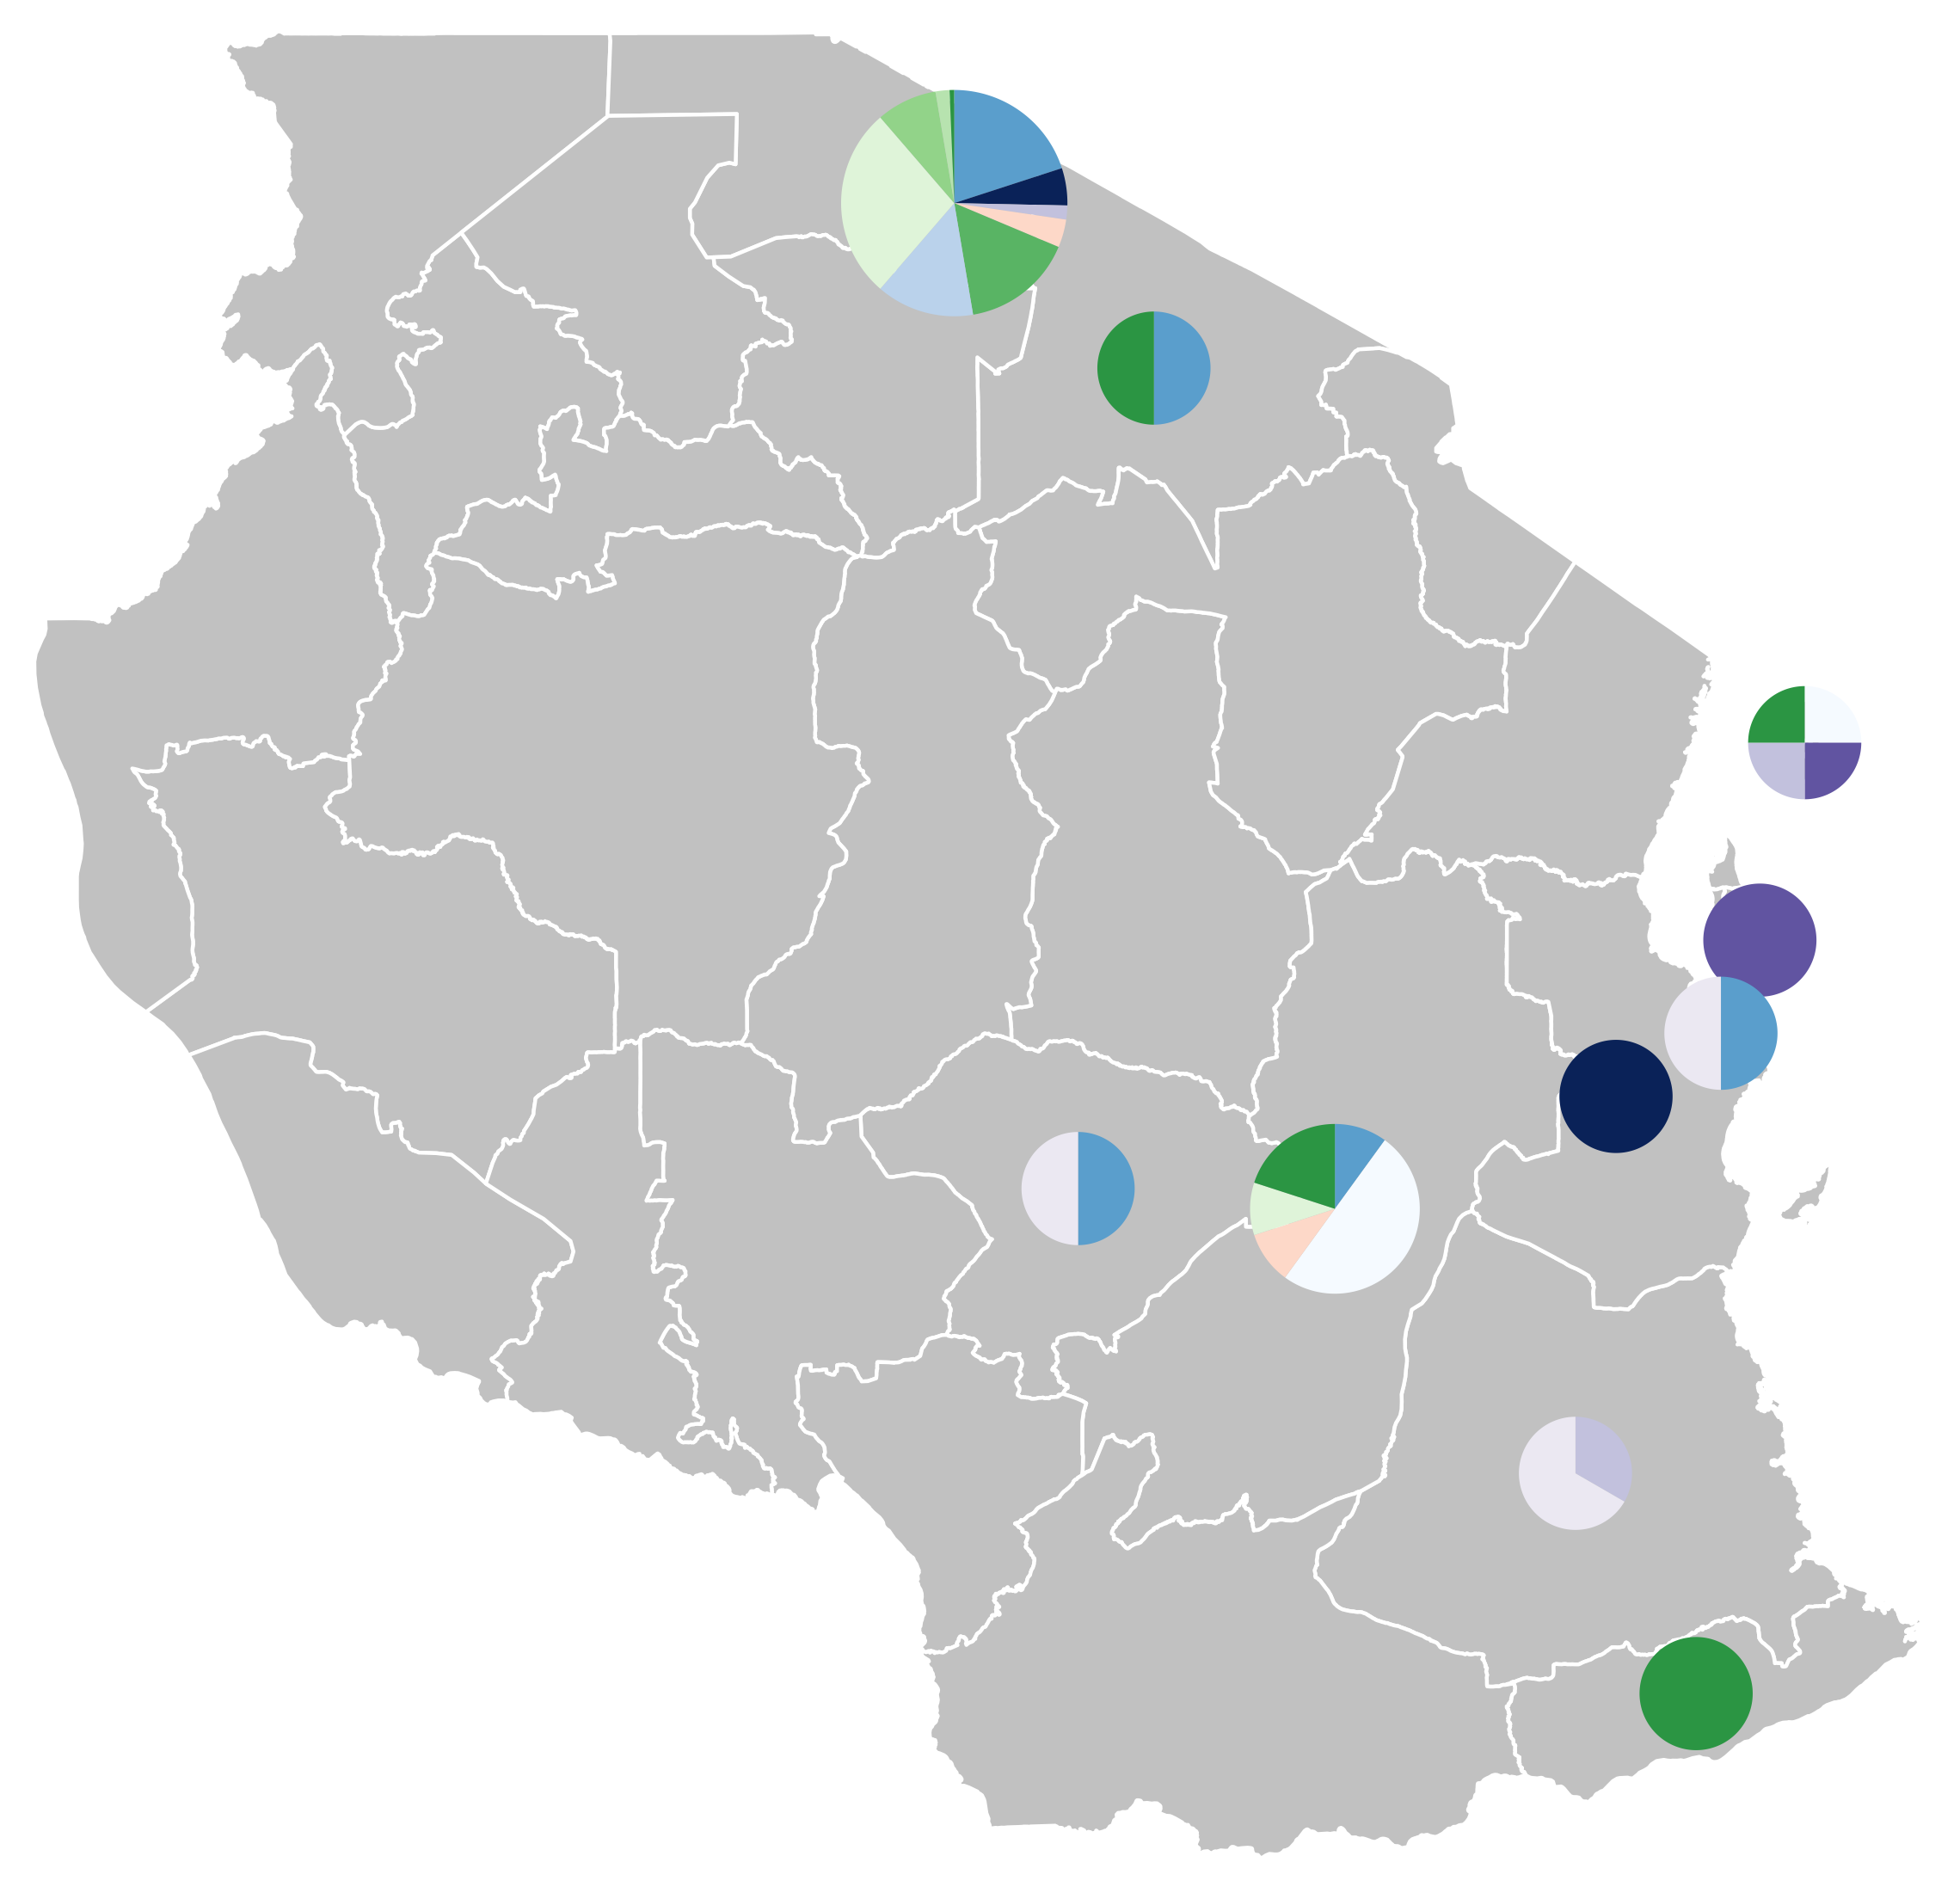
0.003
Notes:
Fig 7. Lineage designations of 224 rabies virus genomes from Tanzania. Maximum likelihood tree with scale in substitutions per site per year, hierarchical relationships, and distribution of lineages. Sequences obtained from RABV-GLUE. Base layer of map from GADM.

Slide 8
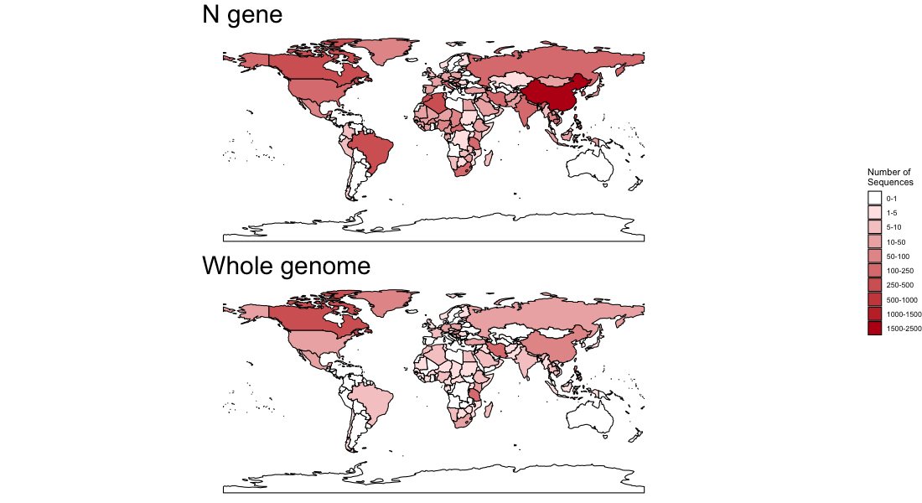
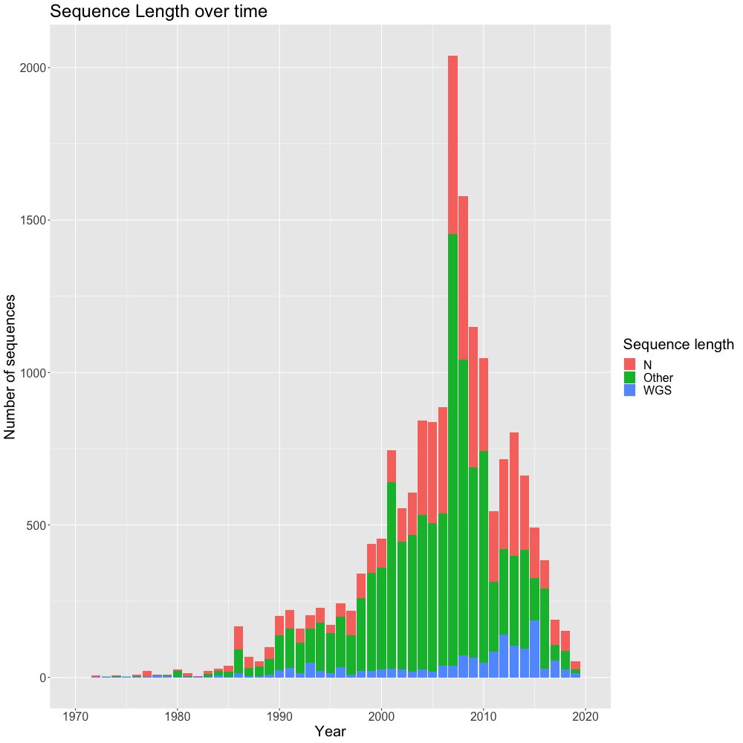
Notes:
S1 Figure - Global Sequence Length Maps and Time Series. Left: Map of collection locations of all available whole genome and N gene sequences. Base layer of map from Natural Earth. Right: Time series of number of whole genome, N gene, and shorter sequences collected.

Slide 9
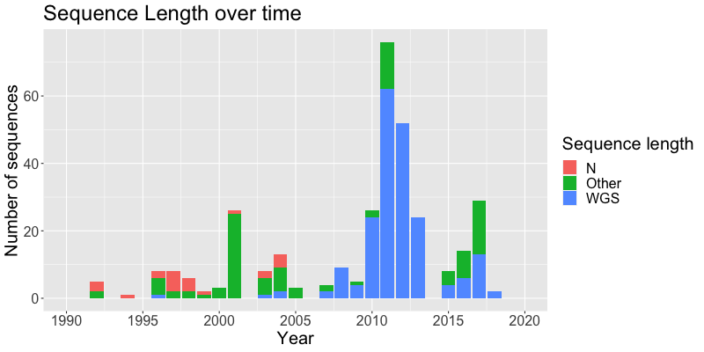
Notes:
S2 Figure - Tanzanian Sequence Length Time Series. Timeseries of the number of whole genome, N gene, and shorter partial genome sequences from Tanzania available on RABV-GLUE.

Slide 10
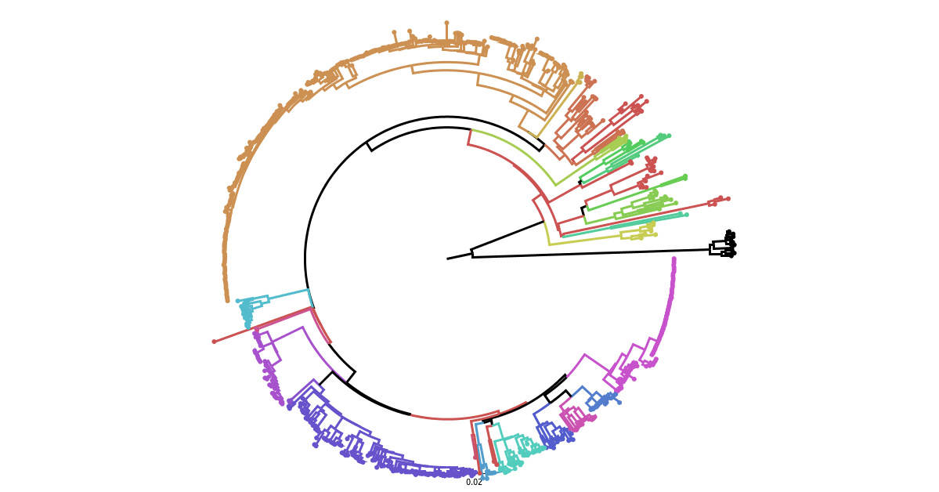
AF1b
AF1c
AF1a
AM1
AM3a
AM3b
AM2b
AM2a
AM4
AF4
COSMOPOLITAN
CA2
NEE
ME2
ME1b
CE
WE
ME1a
EE
CA1
CA3

Slide 11
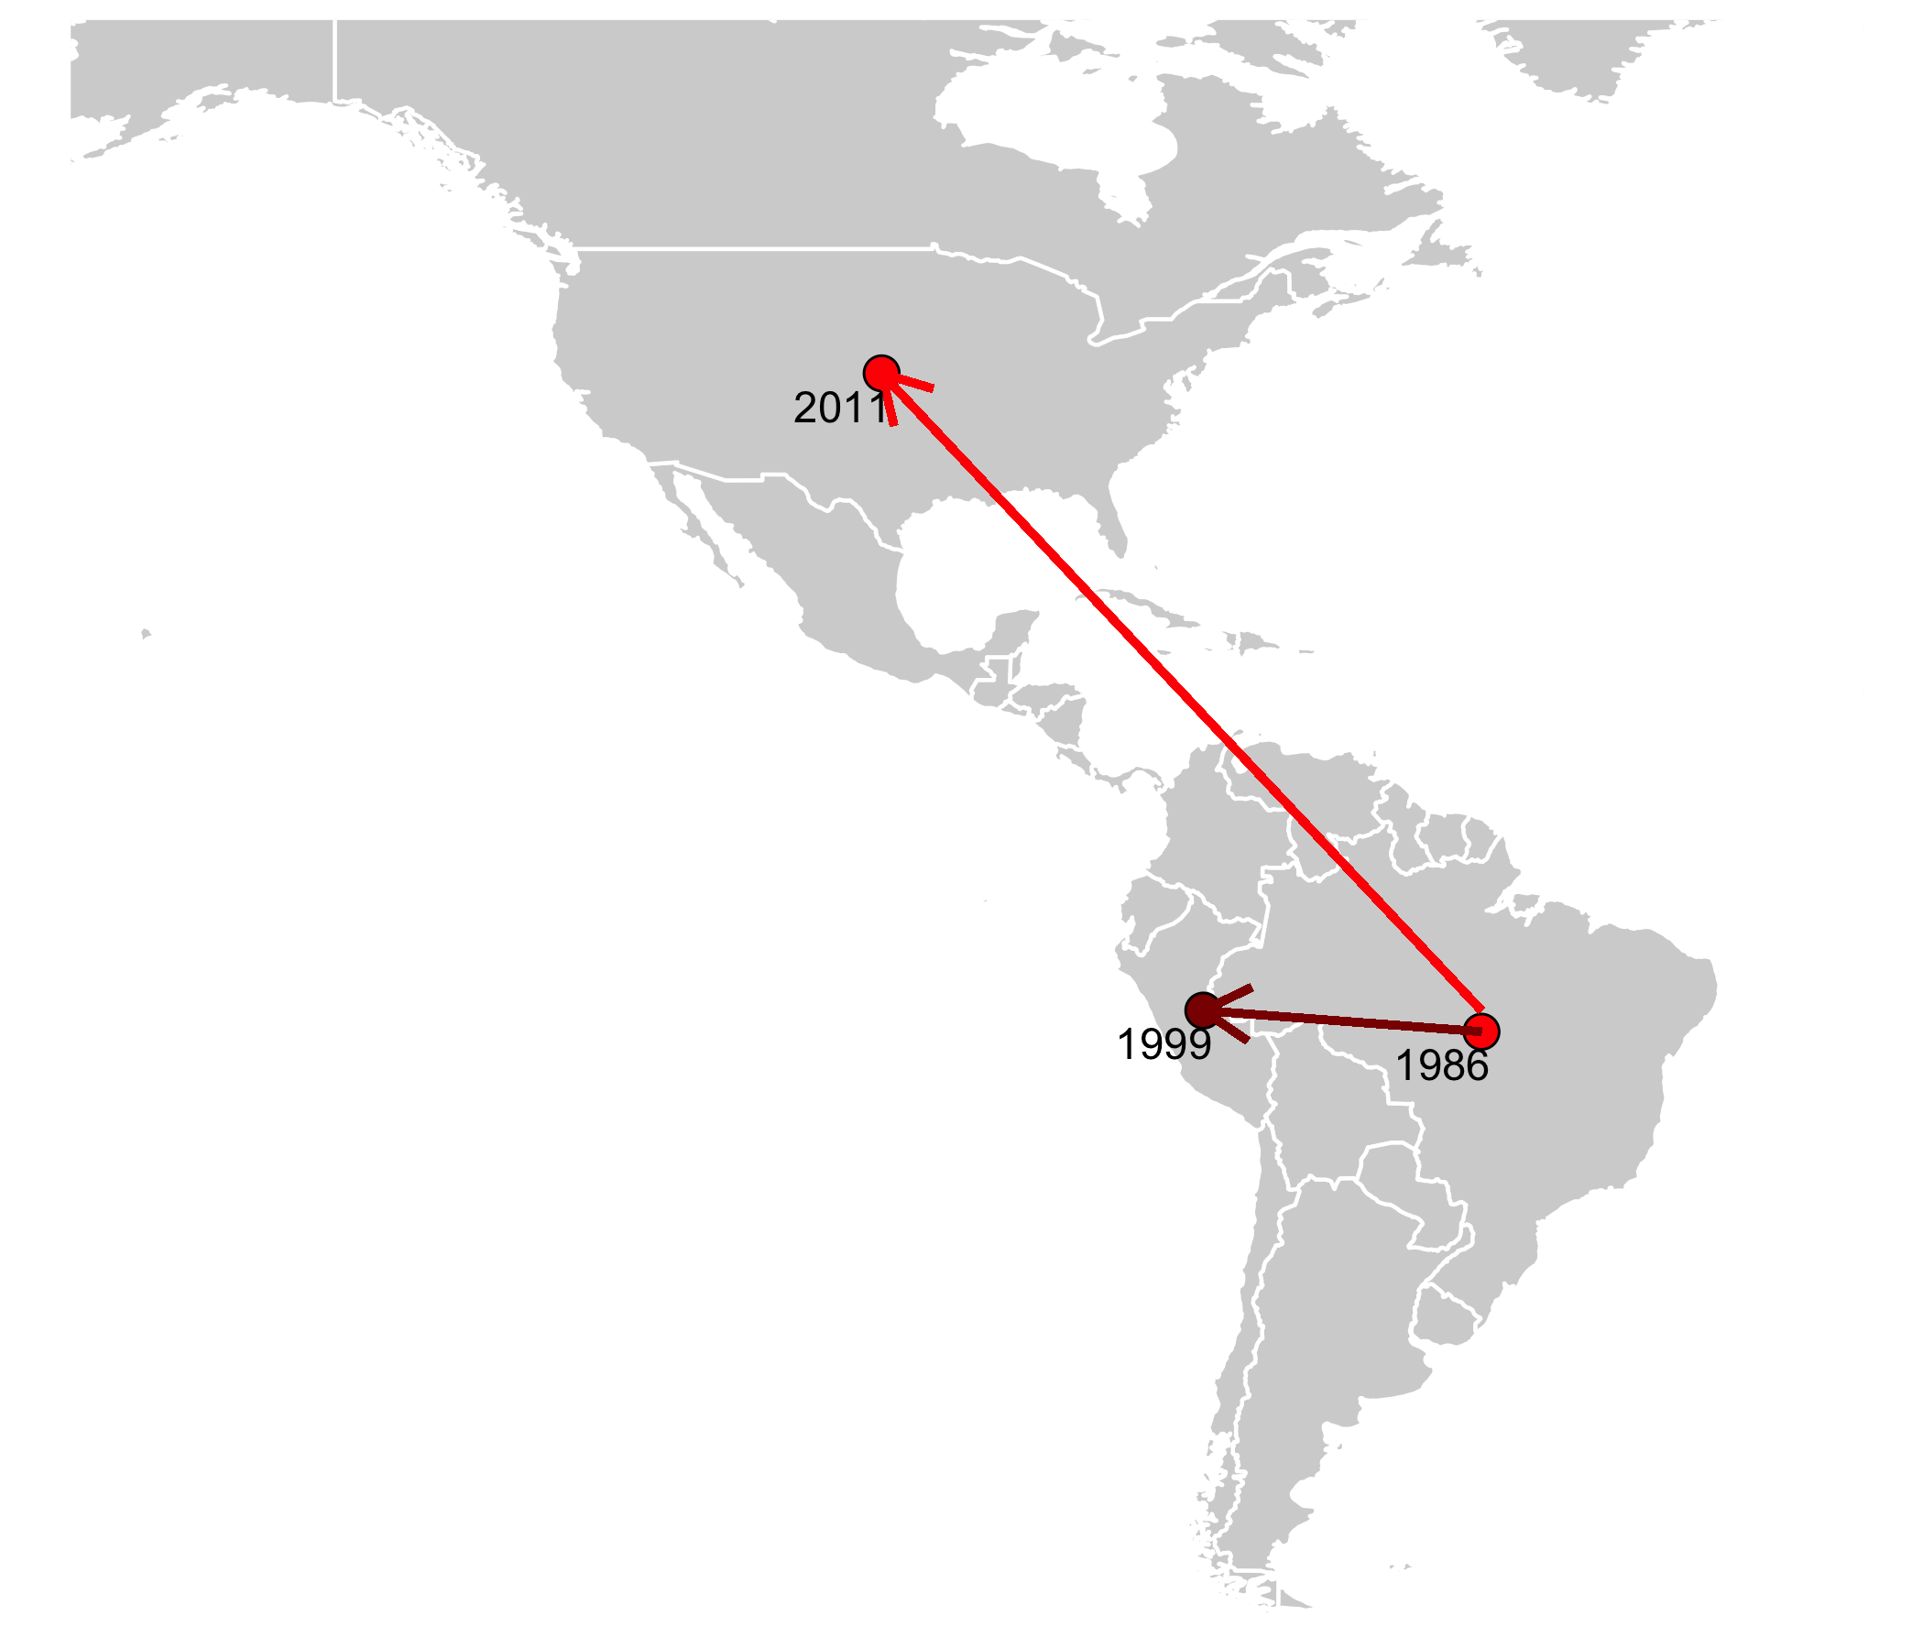
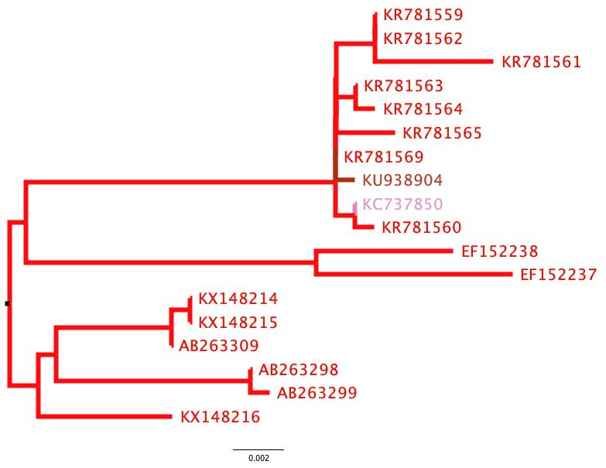
2007
2007
2007
2007
2007
2007
2007
1999
2011
2007
2003
1995
2003
1995
1992
1989
1989
1986
0.002
Notes:
Figure 7 - Global distribution of a lineage over time. Bright red indicates information from WGS lineage designation, whereas the darker red indicated the additional information from N gene lineage designation. Dated points represent introductions into countries, with arrows suggesting the likely route of introduction.

Slide 12
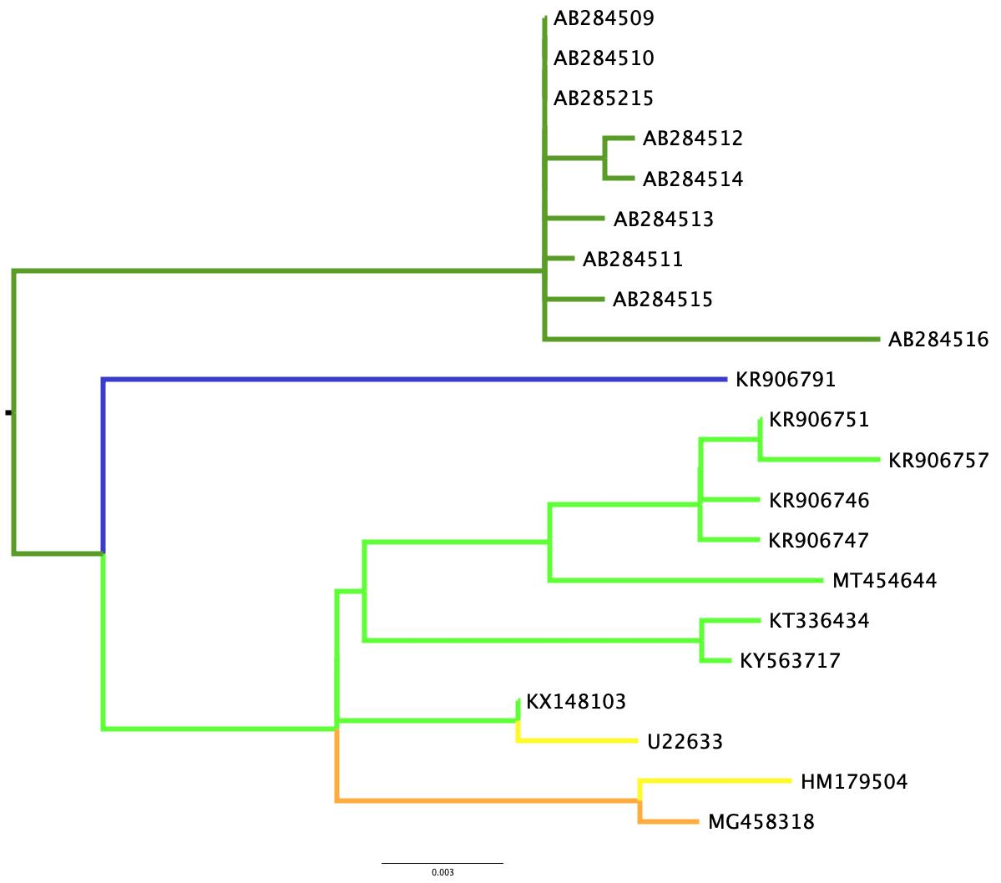
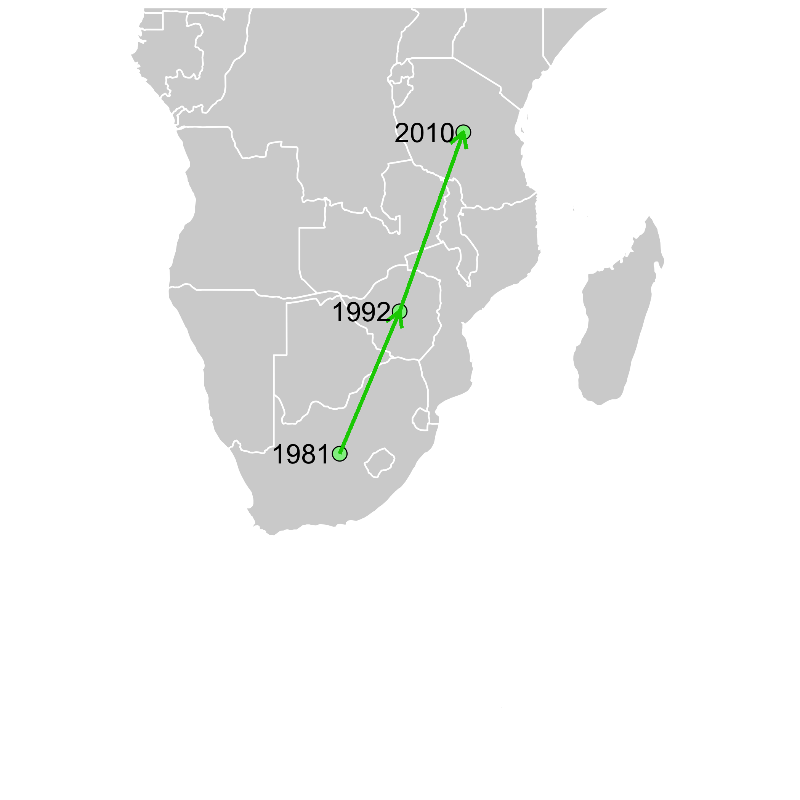
A1.2.1
2000
A1.2.2
1999
C1.1.1
2000
2005
C1
2004
2005
2000
2000
2001
1999
2012
2011
2010
2010
2010
2017
1992
1994
1981
1981
2006
2008
0.003

